Slide 1




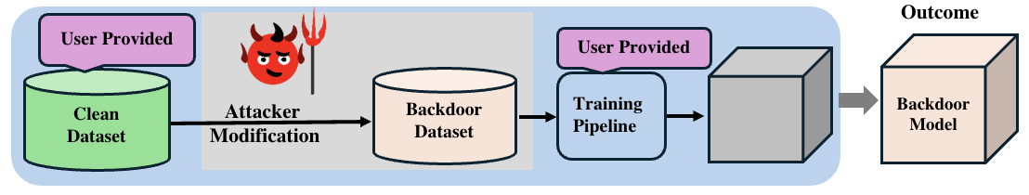
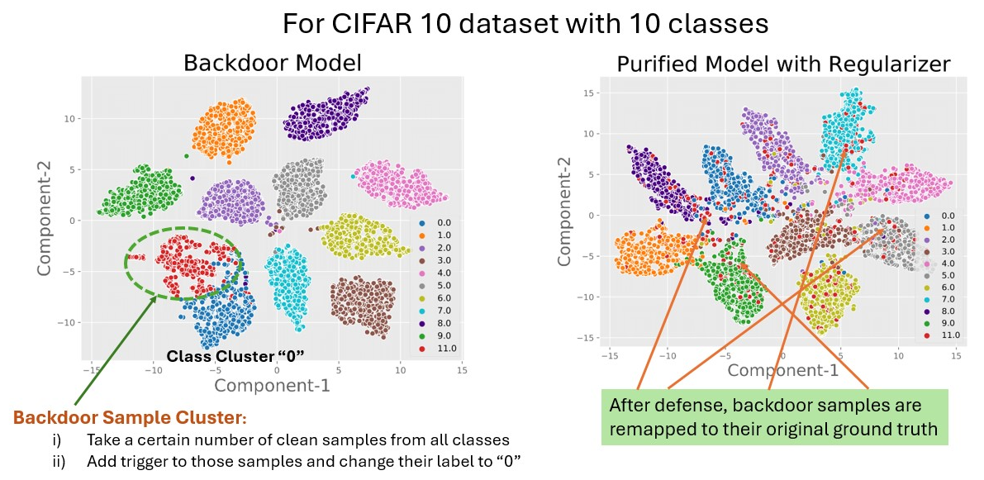
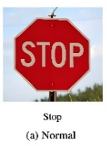


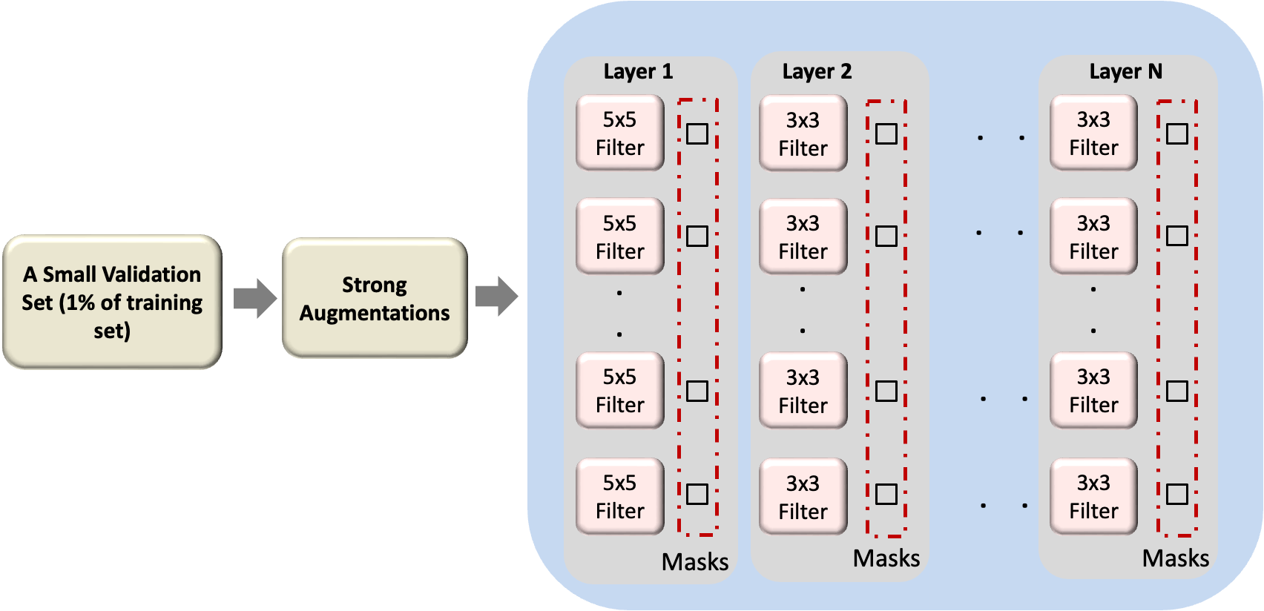
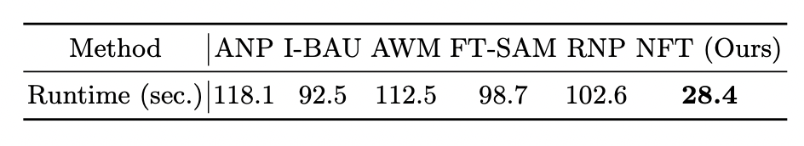
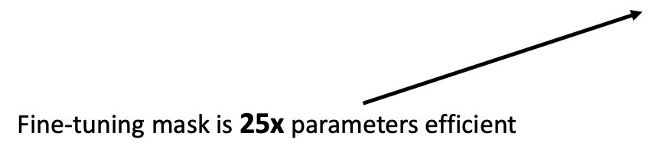
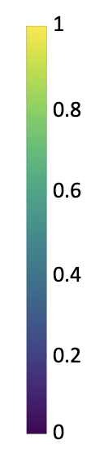
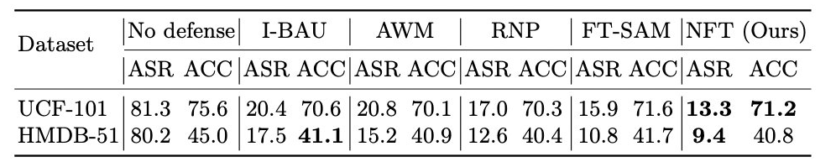
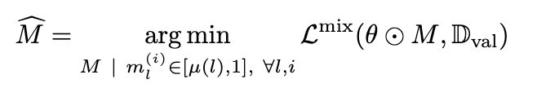
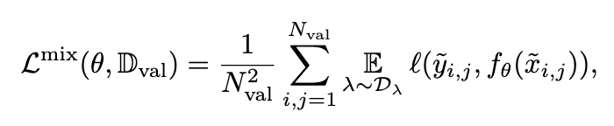

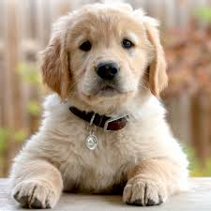

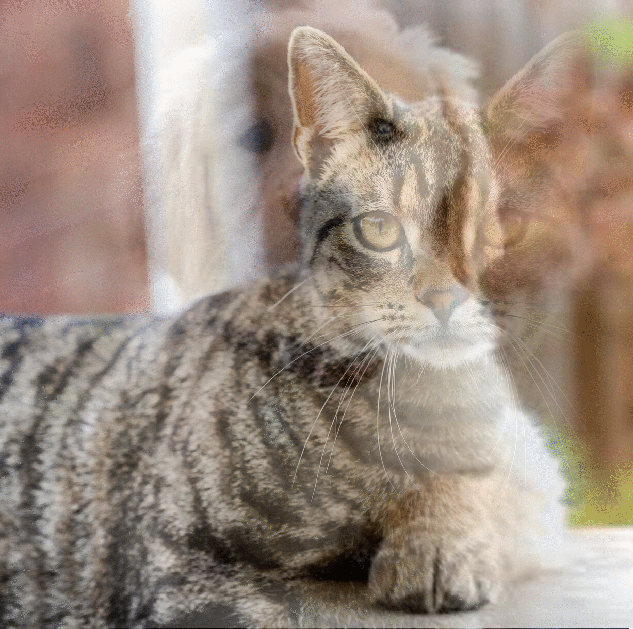


Augmented Neural Fine-Tuning for Efficient Backdoor Purification
Nazmul Karim*
nazmul.karim170@gmail.com
Abdullah Al Arafat+
aalaraf@ncsu.edu
Umar Khalid*
Umarkhalidai@outlook.com
Zhishan Guo+
guo32@ncsu.edu
Nazanin Rahnavard*
Nazanin.Rahnavard@ucf.edu
*: University of Central Florida, Orlando, FL
+: North Carolina State University, Raleigh, NC
Introduction
Backdoor Attack Pipeline
Experimental Evaluation
In Backdoor Attack to Deep Neural Networks, an attacker embeds a hidden trigger in the training data causing normal behavior on clean data but targeted misclassifications when the trigger appears.
Defending against backdoor attacks is crucial for safe and robust AI
T-SNE Visualization of Backdoor and Purified Models
Clean Input
Backdoor Input
Proposed Defense Pipeline
Trigger
Backdoor Model
Clean Model
Neural Mask Fine-tuning (NFT)
Motivation
NFT
Average Runtime on an NVIDIA RTX 3090
mask scheduling reduces the mask search space and improves the computational efficiency
Modifies deeper layers more a they are more affected by the trigger
Major flaws with other defense methods:
  Expensive adversarial search module for either
    Pruning bad neurons
    Synthesizing trigger
  Special type optimizer that updates in more than one forward pass
We aim to eliminate the requirement of adversarial search module by
  Replacing the trigger synthesis process with MixUp augmentation
  Fine-tuning neural masks instead of model weights
  Using Mask Scheduling to better control the mask fine-tuning: significantly reducing the mask search space
NFT is evaluated on four tasks---achieved SOTA performance in most cases
We show results on accuracy (ACC) and attack success rate (ASR) on Action Recognition Datasets below
Mask Distribution
Objective Function
without mask scheduling
MixUp Loss
Concluding Remarks
Sample MixUp
We tackled the backdoor attack in deep learning with a simple yet effective technique, called NFT
NFT’s efficiency and ease of implementation ensure broad applicability across a wide range of modalities
0
1
.
.
0
1
0
.
.
0
mixup
0.6
0.4
.
.
0
$λ$= 0.4
MixUp Goal: The model finds it hard to map the trigger to target label
with mask scheduling
Project Website

