Slide 1
University of Central Florida
IEEE ISEC 2020
Adaptive Behavioral Simulation Framework for
2-Terminal MTJ-based Analog to Digital Converter
Gustavo Camero¹, Soheil Salehi², and Ronald F. DeMara³
¹ECE Department, Carnegie Mellon University; ²ECE Department, University of California – Davis;
³ECE Department, University of Central Florida
Saturday, August 1, 2020 via Zoom meeting
This material is based upon work supported by the National Science Foundation under grant ECCS-1810256. Any opinions, findings, and conclusions or recommendations expressed in this material are those of the author(s) and do not necessarily reflect the views of the National Science Foundation.

Slide 2
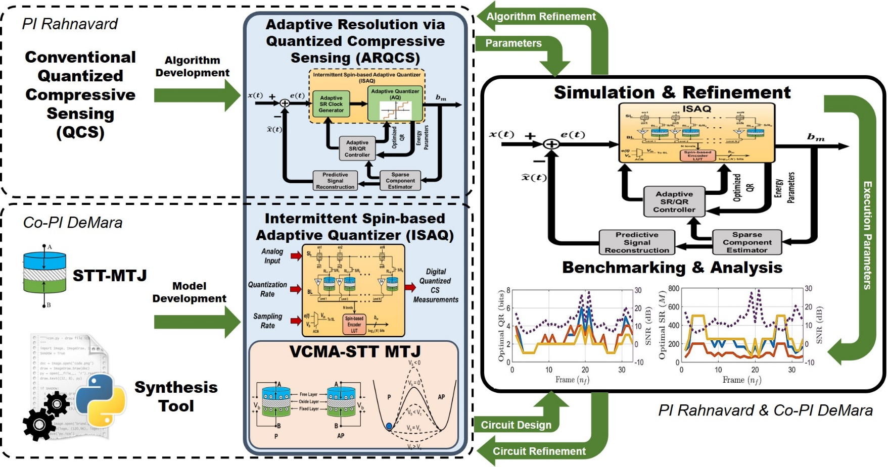
NSF-ECCS-1810256 Spintronic-Enabled Signal Processing
“Cross-layer Adaptive Rate/Resolution Design for Energy-Aware Acquisition of Spectrally Sparse Signals Leveraging Spin-based Devices”
Develop energy-efficient adaptive framework to acquire spectrally-sparse signals
Integrate adaptive quantized Compressive Sensing w/ beyond-CMOS devices

Slide 3
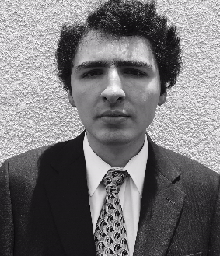
Three Pathways to Educational Impacts
Research Expertise  REU Experiences  High School Outreach
Doctoral Graduates / Students
1)
Foster Scholarly Research Expertise
Soheil Salehi, Ph.D.
Completed Ph.D.; now a Post-Doctoral Researcher at UC-Davis
Adrian Tatulian, M.S.
Doctoral Student
REU Graduates / Students
2)
Mentor Impactful REU Experiences
Gustavo Camero
Completed REU; now a Doctoral Student at Carnegie Mellon Univ.
Adedoyin Adepegba
REU currently interning at Intel
Paul Wood
REU currently interning at Intel
Daniel C. Mulvaney
REU currently interning at L3-Harris

Slide 4
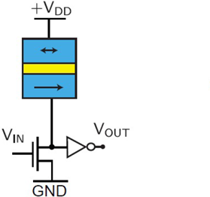
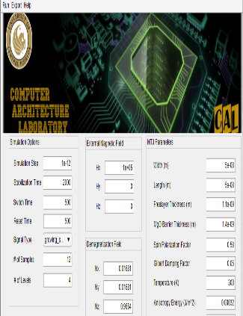
Three Pathways to Educational Impacts
Research Expertise  REU Experiences  High School Outreach
Outreach Goals & Approach
Mentor U/G’s via NSF REU supplement
Paid REUs conducted lit surveys of signal encoding/conversion, performed SPICE simulations w/ MTJ circuits designed by GRAs
REUs learned SPICE circuit modeling tools via structured examples, and practived proofreading of articles composed by team members, post-CMOS technical knowledge and authoring skills
3)
Creating
Educational Outreach for High Schoolers
Spintronic Simulation Website
Simulation Framework is an educational resource site companion to distribute the interactive tool to provide insights of the modeled Spin-based ADC
Broad dissemination through web-based framework to maximize the impact of outreach

Slide 5
Research Motivation Need for CS solutions considering device-level constraints for IoT
✓
There is a need for low-complexity, ultra-low-power circuit for signal conversion for IoT applications
There is a demand for Compressive Sensing solutions that consider hardware constraints and signal constraints for IoT intelligent sampling and edge processing
✓
Design Objectives
Application Characteristics
Reliability
Region of Interest
Performance
Signal-to-Noise Ratio
Energy-Efficiency
Intermittent Operation
Area-Efficiency
Normally-off Computing
Compressive Sensing
Circuit Benchmarking
Reliability Analysis
Challenges
Internet of Things
Reconfigurable Fabric
Process Variation
Design Complexity
Operating Conditions
How can spin-based devices assist Compressive Sensing within IoT applications?
Energy Constraint
Area Constraint
Notes:
Area and Energy efficiency are two of the main challenges of IoT devices. In every IoT application, the goal is to maximize performance while reducing energy consumption, storage needs, and data transmission overheads.
A solution to these challenges is Compressive Sensing. But implementing non-uniform Compressive Sensing in hardware would require Random Number Generators. Either True Random Number Generator or Pseudo Random Number Generator.
PRNGs include Linear Feedback Shift Registers, creates an illusion of randomness. TRNGs, on the other hand, rely on truly random events such as thermal noise, oscillator jitter, and metastability; previous designs of PRNGs and TRNGs suffer from limited quality in the randomness or limited generation speed of the output as well as high energy and area overheads.
Our proposed approach ASSIST, which is short for Adaptive Sampling of Sparse IoT signals via STochastic-oscillators, uses MRAM-based TRNG as well as MRAM-based Non-Volatile Memory to minimize the power dissipation and area while supporting the intermittent operation of IoT applications.

Slide 6
Research Motivation Need for CS solutions considering device-level constraints for IoT¹
Maximize signal sensing and reconstruction performance while reducing energy consumption for IoT applications
Compressive Sensing reduces number of samples per frame to decrease energy, storage, and data transmission overheads
Non-uniform CS in hardware requires Random Number Generator (RNG)
True RNGs vs. Pseudo RNGs
Compressive
Sensing
MRAM-based
NVM
Reduced storage
Near-zero static power dissipation
Reduced area
Non-volatile
Reduced data transmission
Intermittent
AIQ
Low-area
Low-power dissipation
Fast and Signal-dependent
MRAM-based
TRNG
1. This work is funded by NSF-ECCS #1810256 and NSF-CCF#1739635
Notes:
Area and Energy efficiency are two of the main challenges of IoT devices. In every IoT application, the goal is to maximize performance while reducing energy consumption, storage needs, and data transmission overheads.
A solution to these challenges is Compressive Sensing. But implementing non-uniform Compressive Sensing in hardware would require Random Number Generators. Either True Random Number Generator or Pseudo Random Number Generator.
PRNGs include Linear Feedback Shift Registers, creates an illusion of randomness. TRNGs, on the other hand, rely on truly random events such as thermal noise, oscillator jitter, and metastability; previous designs of PRNGs and TRNGs suffer from limited quality in the randomness or limited generation speed of the output as well as high energy and area overheads.
Our proposed approach ASSIST, which is short for Adaptive Sampling of Sparse IoT signals via STochastic-oscillators, uses MRAM-based TRNG as well as MRAM-based Non-Volatile Memory to minimize the power dissipation and area while supporting the intermittent operation of IoT applications.

Slide 7
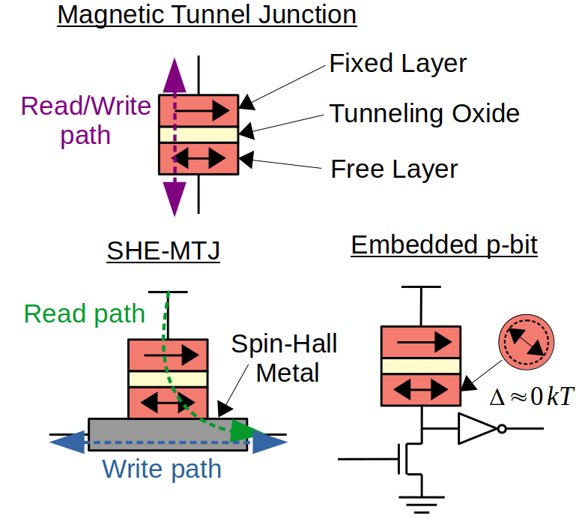
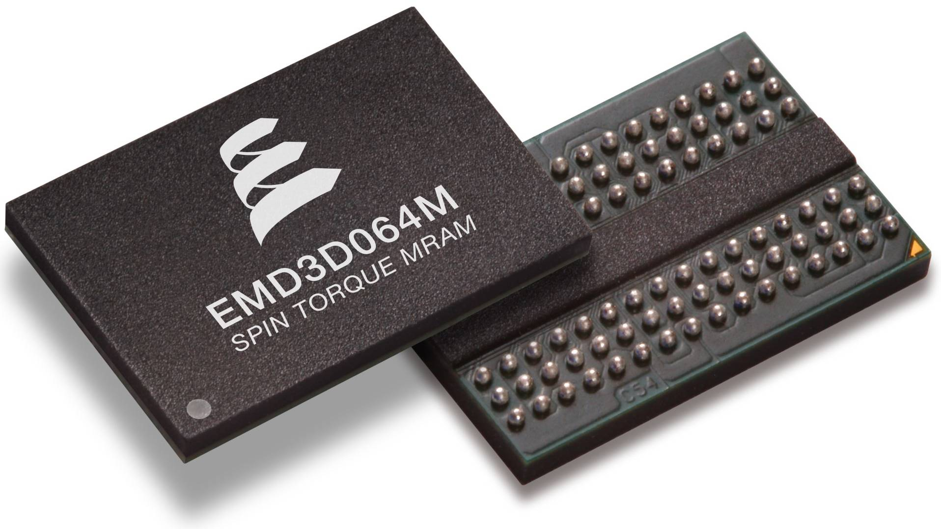
Spin Devices in Reconfigurable Fabrics Time & Space Co-design of Digital, Analog, Storage
Magnetic tunnel junctions (MTJs) consist of a tunneling oxide layer sandwiched between two ferromagnetic layers.
Magnetization of free layer can be modified using a current or voltage.
Low-barrier MTJ can be used to build Magnetic Random Access Memory (MRAM)-based p-bit with stochastic switching capability
https://www.theregister.co.uk/2019/03/08/samsung_mram/

Intel now delivering embedded MRAM (eMRAM) in a 1T1MTJ architecture in conjunction with their 22-nm FinFET technology libraries¹
Everspin & IBM MTJ-based SSD and DRAM replacement products available
Toshiba is fabricating SHE-MTJ²
Advantages
✓
Near-zero standby power
Area efficient
Fast read operation
True randomness
✓

✓
✓

https://www.everspin.com/spin-transfer-torque-mram-products
Wei, Liqiong, Juan G. Alzate, Umut Arslan, et al. "13.3 A 7Mb STT-MRAM in 22FFL FinFET Technology with 4ns Read Sensing Time at 0.9 V Using Write-Verify-Write Scheme and Offset-Cancellation Sensing Technique." In 2019 IEEE International Solid-State Circuits Conference-(ISSCC), pp. 214-216, 2019.
H. Yoda et al., "High-Speed Voltage-Control Spintronics Memory (High-Speed VoCSM)," 2017 IEEE International Memory Workshop (IMW), Monterey, CA, 2017, pp. 1-4.
Notes:
Consist of a tunneling oxide layer sandwiched between two ferromagnetic layers. One of the ferromagnetic layers is considered the fixed layer, and is pinned to a constant magnetic orientation. The orientation of the free layer, on the other hand, can flip.
In a traditional device, there is a significant energy barrier between the two stable free-layer orientations. This energy barrier is typically overcome by passing a spin-polarized current through the device, which causes the device to switch. Once the device switches, it is stable in its new state. Thus, MTJ’s can serve as a form of nonvolatile memory.
MTJ’s can also be fabricated to have low energy barrier between states. In this case, the state of the device can switch spontaneously by thermal activation. This principle is useful in implementing a p-bit, with probabilistic output.
(click pointer)
Overall, spin-based devices offer a number of advantages, including low standby power, area efficiency, fast read operation, and true random number generation.
Commercially, MRAM is gaining popularity with Intel recently announcing their 1T1MTJ embedded-MRAM architecture in conjunction with their 22-nm FinFET technology.

Slide 8
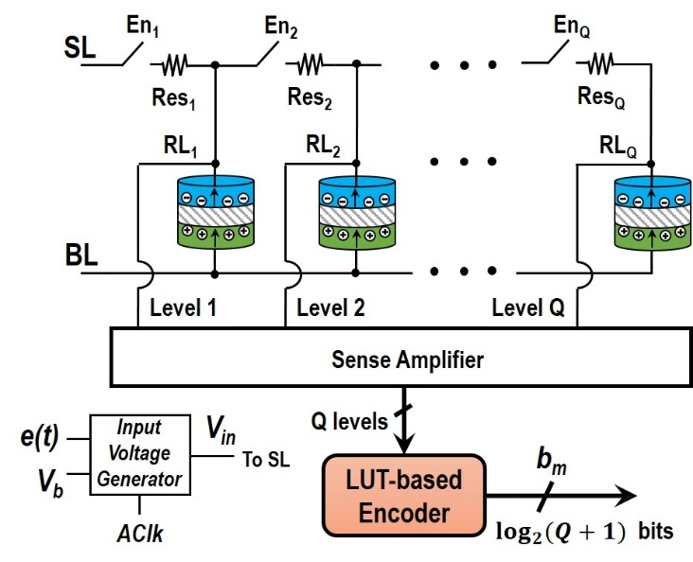
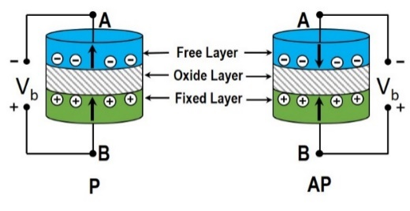
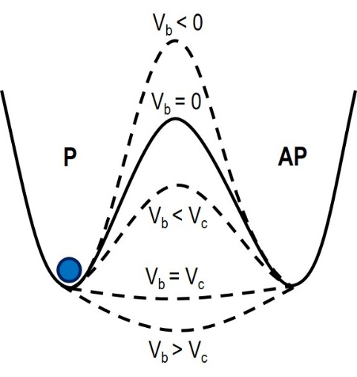
My Proposed Approach
Adaptive Intermittent Quantizer (AIQ) Circuit Design^{1,2}
Voltage-Controlled Magnetic Anisotropy Magnetic Tunnel Junction (VCMA-MTJ) AIQ
During Reset step: all active VCMA-MTJs are reset to Parallel state
During Sampling step: based on determined SR and QR, first bias voltage, V_{b}, is applied across the active VCMA-MTJs to modify energy barrier followed by analog input, e(t), to write into the active VCMA-MTJs
During Read step: use a sense amplifier to read data stored in each VCMA-MTJ
1. S. Salehi, M. Mashhadi, A. Zaeemzadeh, N. Rahnavard, and R. F. DeMara, IEEE JETCAS-2018 2. This work is funded by NSF-ECCS #1810256

Slide 9
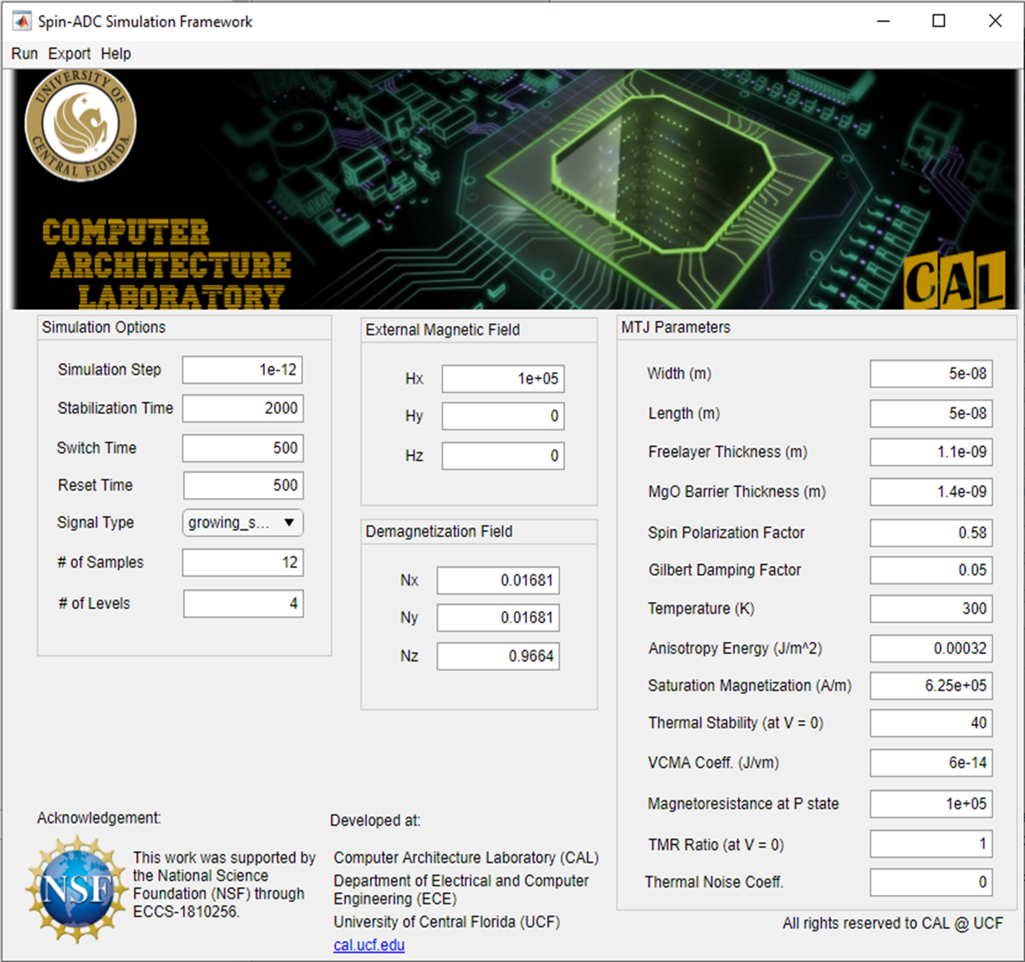
My Proposed Approach
AIQ Simulation Framework^{1,2,3}
Functionalities of proposed Simulation Framework:
Proposed Interactive Simulator provides a Graphical User Interface (GUI) that allows for the modification and insertion of values for Spin-ADC simulations
Default parameter values reflect simulation cases used in [S. Salehi, et al., 2018]²
Vary device parameters for running different simulations with different scenarios
Run option that compiles all parameters and simulation options to display simulation results
Simulation results are displayed in a different GUI window displaying different characteristics
Help option that redirects to various educational resources site for more information
1. G. Camero, S. Salehi, and R. F. DeMara, IEEE ReConfig-2019. 2. S. Salehi, M. Mashhadi, A. Zaeemzadeh, N. Rahnavard, and R. F. DeMara, IEEE JETCAS-2018 3. This work is funded by NSF-ECCS #1810256

Slide 10
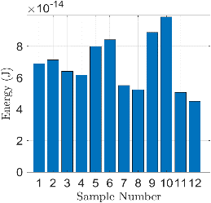
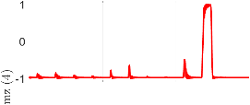
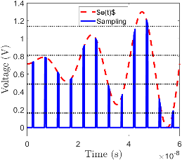
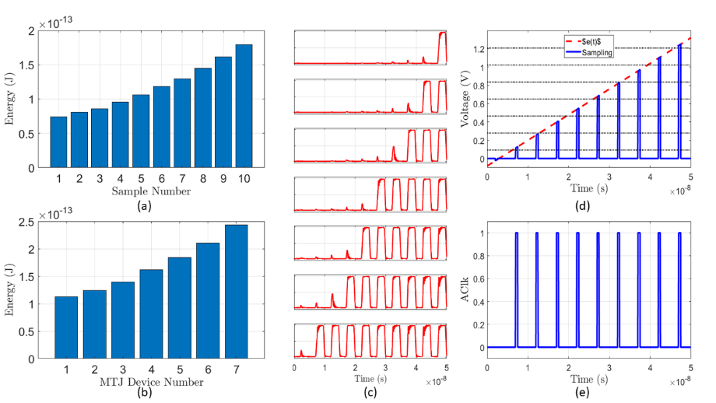
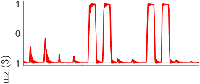
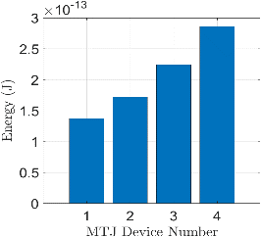
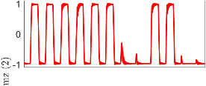
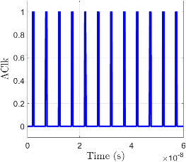
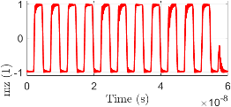
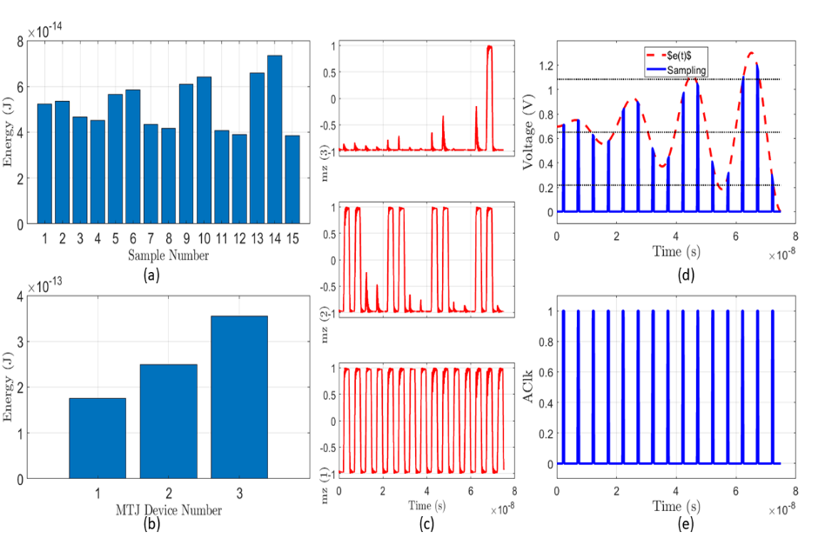
Adaptive & Interactive Framework
AIQ Simulation Framework^{1,2,3}
(a)
(d)
(b)
(c)
(e)
Sample Output Waveforms:
(a) Depicts energy consumed for each sample
(b) Illustrates energy consumed by each MTJ
(c) Shows Magnetization Orientation of each MTJ
(d) Demonstrates analog input waveform
(e) Visualizes Sampling Rate
1. G. Camero, S. Salehi, and R. F. DeMara, IEEE ReConfig-2019. 2. S. Salehi, M. Mashhadi, A. Zaeemzadeh, N. Rahnavard, and R. F. DeMara, IEEE JETCAS-2018 3. This work is funded by NSF-ECCS #1810256

Slide 11
Educational Outreach Goals
CCSS Website¹
Outreach Objectives:
Utilize research findings in undergraduate & graduate coursework.
Develop an interactive tool based on research findings.
Utilize the proposed tool to engage and attract high school students into STEM-related fields.
Use educational resources website for explanation and distribution of the proposed interactive tool.
Current Work:
Youtube Tutorial Video: Simulation Runs with 2-Terminal MTJs
Youtube Tutorial Video: MTJ Parameters Walkthrough
Finalize the export option to save the acquired data from simulations in a spreadsheet document
1. G. Camero, S. Salehi, and R. F. DeMara, IEEE ReConfig-2019. 2. S. Salehi, M. Mashhadi, A. Zaeemzadeh, N. Rahnavard, and R. F. DeMara, IEEE JETCAS-2018 3. This work is funded by NSF-ECCS #1810256

